Slide 1
Beyond the Technical: Small steps to playing bigger
Maggie Carroll
@MaggieCarroll #OReillySACon

Slide 2
So it begins . . . .
@MaggieCarroll

Slide 3
“Hello Maggie,
I attended your talk last year in London, and really appreciated your recommendations on how to take the time to deal with stakeholders. They turned out quite useful and effective for me too.”
H.D. Lead Architect (Paris, France)
Received August 16, 2019 via LinkedIN. . . 10 months after the talk in London
@MaggieCarroll

Slide 4
Software Architecture
Novel Technical Solution
Tailors Sets of Processes
Solve the Problem
@MaggieCarroll

Slide 5
Software Architecture
Novel Technical Solution
Tailored Set of Processes
Influence
@MaggieCarroll

Slide 6
“Master one unit of performance and then use that as the stepping stone to the next one.”
-James Clear, author of Atomic Habits
@MaggieCarroll

Slide 7
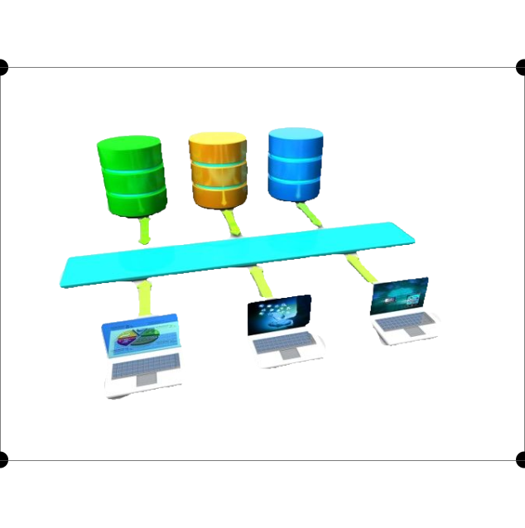
A Tale of Two Architecture Challenges . . . .
Renew
Integrate
@MaggieCarroll

Slide 8
A Tale of Two Architecture Challenges . . . .
New EA Function in Org Chart
New Web Presence
Align Business Areas
Renew
@MaggieCarroll

Slide 9
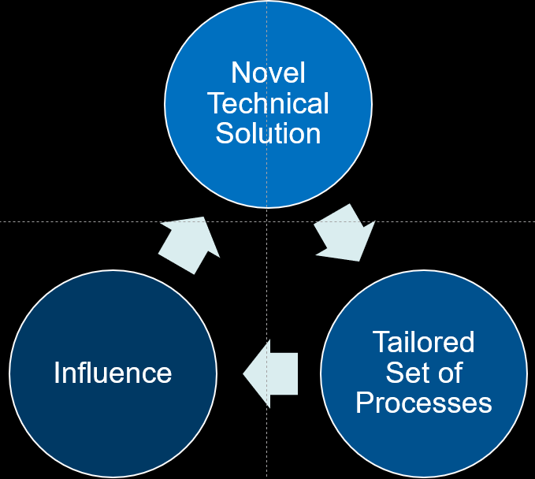
A Tale of Two Architecture Challenges . . . .
New EA Function in Org Chart
New Web Presence
Align Business Areas
Renew
@MaggieCarroll

Slide 10
A Tale of Two Architecture Challenges . . . .
Enterprise Architecture
Business Areas
IT Dev Ops
Vendors
Project Manager
Business Area
Business Analysts
Business Area
IT QA
IT Database
IT Env
IT Infrastructure
Renew
@MaggieCarroll

Slide 11
A Tale of Two Architecture Challenges . . . .
Enterprise Architecture
Business Areas
IT Dev Ops
Vendors
Project Manager
Business Area
Business Analysts
Business Area
IT QA
IT Database
IT Env
IT Infrastructure
Renew
@MaggieCarroll

Slide 12
A Tale of Two Architecture Challenges . . . .
“Integration Effort not Development Effort”
Multiple Vendor Integration
Crunch Schedule
Integrate
@MaggieCarroll

Slide 13
A Tale of Two Architecture Challenges . . . .
“Integration Effort not Development Effort”
Multiple Vendor Integration
Crunch Schedule
Integrate
@MaggieCarroll

Slide 14
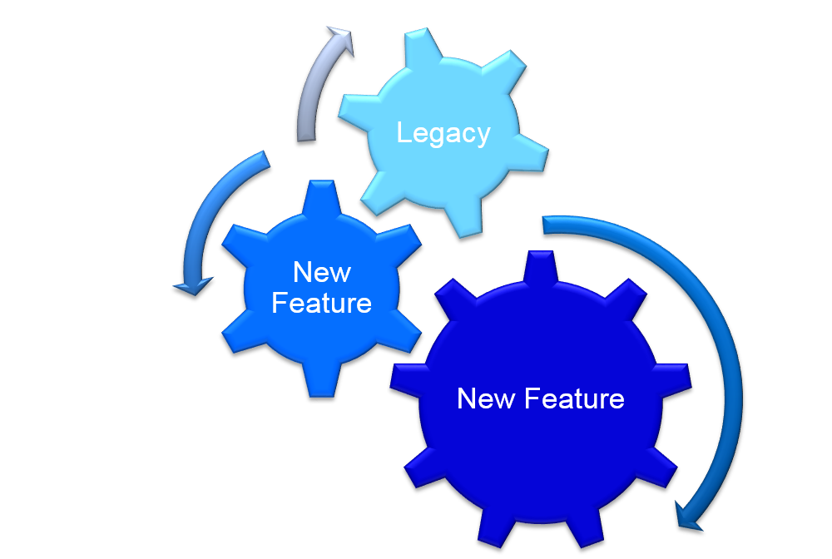
A Tale of Two Architecture Challenges . . . .
External
Interface
Vendor
Key Business
Systems
Vendor
Platform
Vendor
External Interface Vendor
Integration Team
External Interface Vendor
Integrate
@MaggieCarroll

Slide 15
A Tale of Two Architecture Challenges . . . .
External
Interface
Vendor
Key Business
Systems
Vendor
Platform
Vendor
External Interface Vendor
Integration Team
External Interface Vendor
Integrate
@MaggieCarroll

Slide 16
@MaggieCarroll

Slide 17
Influence
Rely on other Experts
Authority must be earned by influence
Act
Identify Common Goals
Identify Stakeholders – List them
@MaggieCarroll

Slide 18
Lead
Rely on other Experts
Authority must be earned by influence
Act
Identify Common Goals
Identify Stakeholders – List them
Influence
Ask questions that enhance a mindset
Ask questions that clarify a mindset
@MaggieCarroll

Slide 19
Lead
Rely on other Experts
Authority must be earned by influence
Act
Identify Common Goals
Identify Stakeholders – List them
Ask questions that enhance a mindset
Control your own work framework
Influence
Ask questions that clarify a mindset
@MaggieCarroll

Slide 20
Starting with the end in mind: What is the goal?
Technology Refresh to enable business and future business
Business Areas – Individual Goals
Project Managers – Successful Project Execution
IT – Successful Software Releases
Renew
@MaggieCarroll

Slide 21
Starting with the end in mind: What is the goal?
Integrate New Features, Improvements to Mission
Ensure Vendor Interfaces are Solid
Open Communication
Identify Gaps
Create review and governance systems
Integrate
@MaggieCarroll

Slide 22
Starting with the end in mind: What is the goal?
Main Goal:
Technology enables the business.
Stakeholder Alignments:
Membership : The user experience guides new members to renew membership after one year and two years.
Membership: The experienced members consider our site to be their main source for knowledge products.
UIX Team: The user experience of the website feels unified with the user experience for events.
Marketing : Marketing data is available and actionable, and easy to generate new marketing materials.
Project Managers: The projects are aligned and sized to meet objectives.
IT Dev Ops: The selected software aligns with our stack, is compatible, and does not duplicate.
Renew
@MaggieCarroll

Slide 23
Starting with the end in mind: What is the goal?
Main Goal:
Integration effort, not development effort.
Stakeholder Alignments:
The platform supports key business system and external interfaces.
The key business system integrates seamlessly with the established platform.
The integration team has knowledge of compatible software versions and hardware requirements.
The test team has a detailed understanding of scope and changes.
The system operators are able to easily understand what action is necessary for health and status condition notifications.
Integrate
@MaggieCarroll

Slide 24
Build your Influence Muscles
Lead
Rely on other Experts
Authority must be earned by influence
Act
Identify Common Goals – One Tagline
Identify Stakeholders – List them
Ask questions enhance a mindset
Control your own work framework
Influence
Identify Stakeholder Alignments to Goals – List them
Ask questions that clarify a mindset
@MaggieCarroll

Slide 25
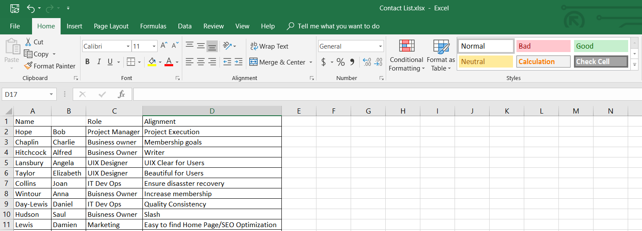
Starting with the end in mind: Sample Contact List
@MaggieCarroll

Slide 26
Starting with the end in mind: What is the goal?
Main Goal:
Technology enables the business
Artifacts:
Roadmap for Projects Governance Specification Vendor Selection Rubric
Main Goal:
Integration effort, not development effort
Artifacts:
Architecture Diagrams which clarify Interfaces
Data flow Interface Specifications Event Traces
Renew
Integrate
@MaggieCarroll

Slide 27
Build your Influence Muscles
Lead
Rely on other Experts
Authority must be earned by influence
Act
Identify Common Goals – One Tagline
Identify Stakeholders – List them
Ask questions enhance a mindset
Control your own work framework
Influence
Identify Stakeholder Alignments to Goals – List them
Ask questions that clarify a mindset
Identify Key Artifacts (1-3)
@MaggieCarroll

Slide 28
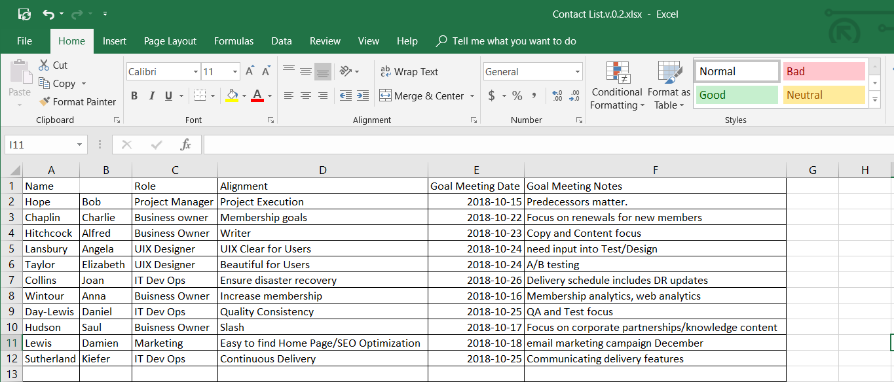
Starting with the end in mind: Contact List updated
@MaggieCarroll

Slide 29
Enterprise Architecture A spectrum of goals, scopes, and entry points
Business Value
Cost Reduction
Design for extensibility
Aim for a single solution
Minimize duplication
Reduce complexity
Risk Reduction
Buy vs Build
Technology fast follower
Security is managed at enterprise level
Avoid single points of failure
Identify a single system of record
Improve Business Agility
IT Roadmaps align architecture updates to support business goals
Analytics support business decision making
Separation of concerns
Stakeholder Value
UI drives customer experience
Support 360 View
“Try before buy”
Enabling <our company> to Turn Change into a Competitive Advantage
@MaggieCarroll

Slide 30
EA Guiding Principles
Link Enterprise Roadmaps with Business Strategy
Demonstrate Business Value
Lead and Support Technology Change Enabling Business Outcomes
Roadmaps are Incremental, Agile, Evolving
Outcome Oriented
Enterprise Scope: Technology, Business, People, Process, Information
@MaggieCarroll

Slide 31
Build your Influence Muscles
Lead
Rely on other Experts
Authority must be earned by influence
Act
Identify Common Goals – One Tagline
Identify Stakeholders – List them
Ask questions enhance a mindset
Control your own work framework
Influence
Identify Stakeholder Alignments to Goals – List them
Ask questions that clarify a mindset
Identify Key Artifacts (1-3)
Circle Back with Stakeholders: Key Artifacts, Alignment to Goals
Consistent, Collaborative Message: Business Value, Key Principles
@MaggieCarroll

Slide 32
Gaining Influence Starts with Ownership
Main Goal:
Technology enables the business.
Stakeholder Alignments:
Project Managers: The projects are aligned and sized to meet objectives.
Renew
@MaggieCarroll

Slide 33
Gaining Influence Starts with Ownership: contact list updated
@MaggieCarroll

Slide 34
Gaining Influence Starts with Ownership
Main Goal:
Integration effort, not development effort.
Stakeholder Alignments:
The platform supports key business system and external interfaces.
Integrate
@MaggieCarroll

Slide 35
Build your Influence Muscles
Lead
Rely on other Experts
Authority must be earned by influence
Act
Identify Common Goals – One Tagline
Identify Stakeholders – List them
Ask questions enhance a mindset
Control your own work framework
Influence
Identify Stakeholder Alignments to Goals – List them
Ask questions that clarify a mindset
Identify Key Artifacts (1-3)
Circle Back with Stakeholders: Key Artifacts, Alignment to Goals
Consistent, Collaborative Message: Business Value, Key Principles
Identify Goal for Meeting – What is the Purpose and Desired Result
Review Meeting Goals and Frequency with Stakeholders
Create a Business Rhythm
@MaggieCarroll

Slide 36
Energizing the Team – Team “Business Rhythm”
EA Team Meeting . . Weekly
Scrum Masters . . . Weekly
Innovation Meetings . . . Occasionally
Working Group . . Weekly
Team Tag Up. . . Weekly
Renew
Integrate
@MaggieCarroll

Slide 37
Energizing the Team – Innovation Meetings
Challenge:
Estimate
“Too hard to estimate”
“Not enough time”
“Just not good at it”
Estimation Exercise – works due to trust
Adding “T Shirt Estimation” to our process . . . . . Without fully including the implementation team . . . leads to distrust
Writing a process and asking for review . . . Gains no adoption
Renew
@MaggieCarroll

Slide 38
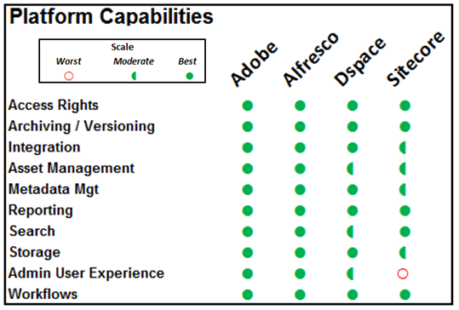
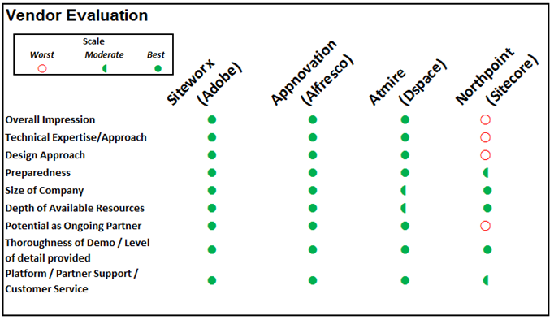
Energizing the Team – Governance that works
Challenge:
Select vendor software
Response to PM request for EA
Meet with EA weekly
EA Technical Investigation
EA Recommendation (Templated)
EA “Proof Of Capability”
Vendor Selection Rubric (Business Analyst)
Renew
@MaggieCarroll

Slide 39
Energizing the Team – Governance that works
Challenge:
Analyze Integration Endpoints
Identify Interfaces “not well known”
Create Event Trace
Vendor Walk through
Update
Vote to promote to baseline review board
Integrate
@MaggieCarroll

Slide 40
Build your Influence Muscles
Lead
Rely on other Experts
Authority must be earned by influence
Act
Identify Common Goals – One Tagline
Identify Stakeholders – List them
Ask questions enhance a mindset
Control your own work framework
Influence
Identify Stakeholder Alignments to Goals – List them
Ask questions that clarify a mindset
Identify Key Artifacts (1-3)
Circle Back with Stakeholders: Key Artifacts, Alignment to Goals
Consistent, Collaborative Message: Business Value, Key Principles
Identify Goal for Meeting – What is the Purpose and Desired Result
Review Meeting Goals and Frequency with Stakeholders
Create a Business Rhythm
Implement Governance in Small Steps
@MaggieCarroll

Slide 41
Lather, Rinse, Repeat
Technology enables the business
Integration effort, not development effort
Renew
Integrate
@MaggieCarroll

Slide 42
Build your Influence Muscles
Lead
Rely on other Experts
Authority must be earned by influence
Act
Identify Common Goals – One Tagline
Identify Stakeholders – List them
Ask questions enhance a mindset
Control your own work framework
Influence
Identify Stakeholder Alignments to Goals – List them
Ask questions that clarify a mindset
Identify Key Artifacts (1-3)
Circle Back with Stakeholders: Key Artifacts, Alignment to Goals
Consistent, Collaborative Message: Business Value, Key Principles
Identify Goal for Meeting – What is the Purpose and Desired Result
Review Meeting Goals and Frequency with Stakeholders
Create a Business Rhythm
Implement Governance in Small Steps
Evaluate Weekly. Friday. 2pm. 1 hour of focus time, favorite beverage. Walk through all “Act” items and analyze
Communicate with stakeholders on key notes from weekly analysis
@MaggieCarroll

Slide 43
Communicate with Stakeholders
On the business rhythm
Continually update and pitch your artifacts, articulate your value, and continually sell
Implement useful changes, even if they don’t have acceptance yet
@MaggieCarroll

Slide 44
Please Rate This Session . . . .
@MaggieCarroll

Slide 45
T h a n k Y o u
Let’s stay in contact:
@MaggieCarroll
Linkedin.com/in/MaggieCarroll
CarrollApproach@gmail.com
Margaretann.Carroll@magaero.com

